Slide 1
Jermyn Borough Council Meeting
03/31/2025

Slide 2
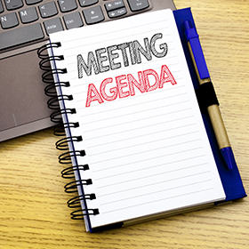
Meeting Agenda
March 31, 2025
CALL TO ORDER
PLEDGE OF ALLEGIANCE
ROLLS CALL
PREVIOUS MEETING MINUTES
TREASURER REPORT/BILLS PAYABLE
SECRETARY REPORT
CORRESPONDENCE
PUBLIC COMMENT
PROFESSIONAL REPORTS-POLICE, FIRE, SOLICITOR, ZONING, ENGINEER, TAX COLLECTOR, MAYOR
COMMITTEE REPORTS-SAFETY, PLANNING, FINANCE, SHADE TREE, REC, MS4, DPW
BID OPENING FOR JERMYN PAVING PROJECT
IRON NEBULA IT
RESOLUTION AUTISTIC SIGNS LACKAWANNA AVE.
NORLACK MEETING
NEW BUSINESS

Slide 3
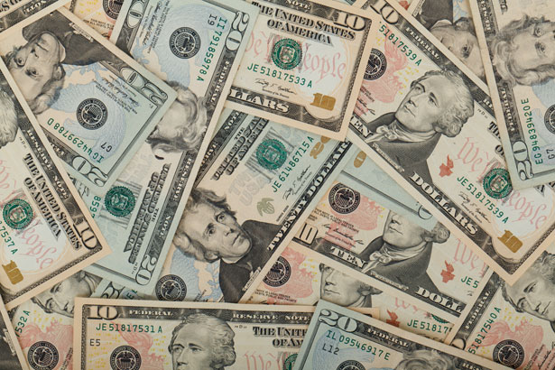
Treasurer’s report
3/31/2025
ASSETS
Checking/Savings
American Rescue Plan Fund 94,582.19
Capital Reserve - DPW 1,083.69
Capital Reserve - Police 6,409.82
Crime Watch Fund 222.69
General Fund - Community 34,435.46
General Fund - FNB 3,723.67
Holiday Lights Fund 400.59

Slide 4
Treasurer’s report
Investment - General Fund 1,129.45
Investment - Liquid Fuels 24,868.09
Investment - Paving Fund 1,141.20
Investment - Recycling 124.72
Investment - Refuse 177.85
Liquid Fuels - FNB 61,458.41
Petty Cash 194.00
Recreations Fund 29,637.15
Recycling - Community 6,396.07
Refuse Checking - FNB 28,338.84
Total Checking/Savings 294,323.89

Slide 5
Treasurer’s report
200000 · Accounts Payable 15,779.27
Long Term Debt 80,180.58

Slide 6
MS4 Minute
https://www.youtube.com/watch?v=sBhzpZD8i8s

